Slide 1

Chandigarh University
Department of Mathematics
B.Tech. CSE (Core/DS/IT/CC)
Semester-3
Subject Code:25MTT-202
Discrete Mathematics
Unit - 4 (Chapter- 4.2.2)
Dr. SARTAJ
DISCOVER . LEARN . EMPOWER

Slide 2

CO mappings

Slide 3

CO-PO mappings
Note: Degree of relevance/correlation: 1-Low, 2-Medium, 3-High, Blank or ‘- ‘- Nil

Slide 4
Topics Overview
Eulerian graph
Conclusions
Video links
References

Slide 5
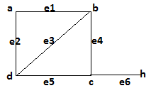
Graph related terms
Walk: It is a sequence of vertices where two consecutive vertices represent edge. (i.e.) It is an alternate sequence of vertices and edge where first and last position must be vertex.
Example. a e₁ b e₃ d e₂ a e₁ b e₄ c e₆ h
It is also written as: a b d a b c h
Trail: It is a walk where no edge will be repeated.
Example. b d a b c
Path: It is a walk where no edge and vertex will be repeated.
Example. d a b c
ns

Slide 6
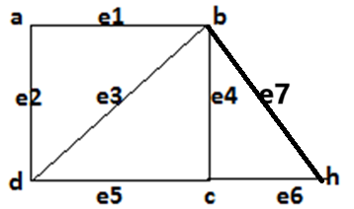
Graph related terms
Note: Number of edge in walk/trail/path is the length of it.
Circuit: A closed trail is a circuit.
(vertices can be repeated but edges can’t be repeated)
Example: b a d b c h b
Cycle: A closed path is a cycle.
(both vertices and edges can’t be repeated)
Example: b a d b
ns

Slide 7
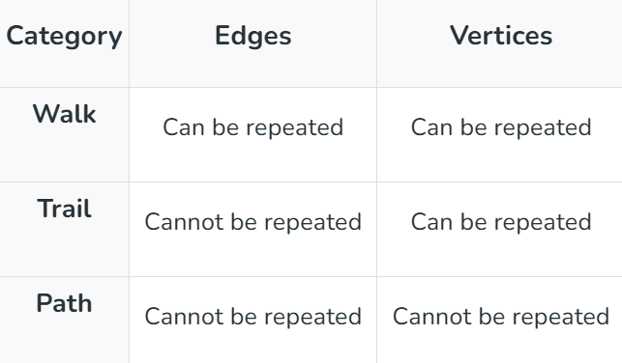
Graph related terms
ns

Slide 8
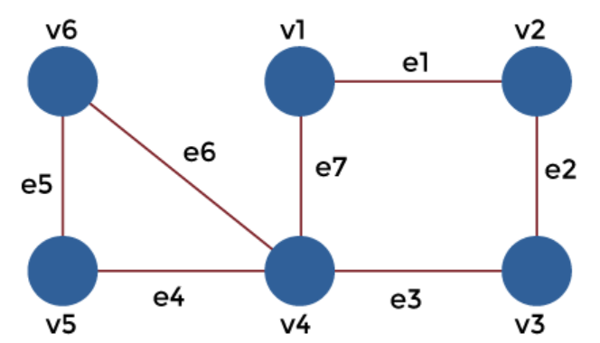
Activity-1
Which of the following walks is a trail, path, circuit, cycle?
v1, v2, v3, v2
v4, v1, v2, v3, v4, v5
v1, v2, v3, v4, v5
v1, v2, v3, v4, v1
v6, v5, v4, v3, v2, v1, v4, v6

Slide 9
Euler paths and Graphs
Euler path: It is a path that uses every edge of the graph G exactly once.
Euler trail: It is a trail that uses every edge of the graph G exactly once.
Euler circuit: It is a circuit that uses every edge of the graph G exactly once.
Euler cycle: It is a cycle that uses every edge of the graph G exactly once.
Euler Graph: A connected graph is a Euler graph if it has a Euler trail.

Slide 10
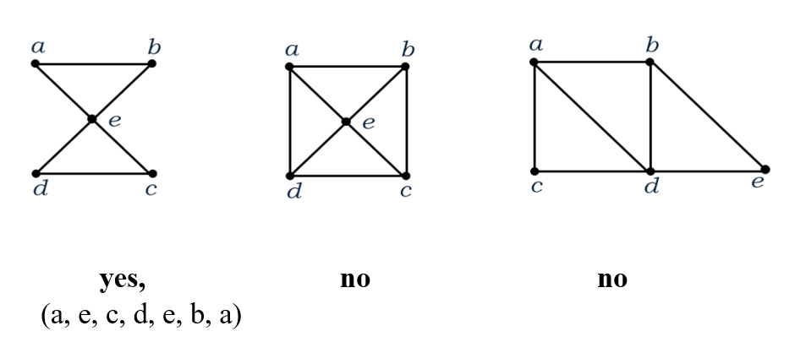
Euler paths and Graphs
Example: Which of the following graphs have a Euler Circuit?

Slide 11
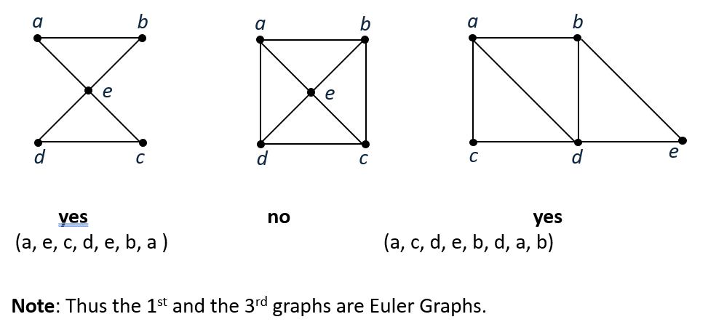
Euler paths and Graphs
Example: Which of the following graphs have a Euler trail?

Slide 12
Euler paths and Graphs
Necessary and Sufficient Conditions
A connected multigraph has a Euler circuit if and only if each of its vertices has an even degree.
A connected multigraph has a Euler path but not a Euler circuit if and only if it has exactly two vertices of odd degree.

Slide 13
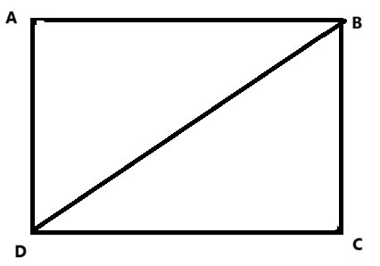
Euler paths and Graphs
Example: A city has 6 intersections connected by roads as follows: A is connected to B and D; B is connected to A, C, and D; C is connected to B and D; D is connected to A, B, and C. Can a street-sweeping truck start at any intersection, sweep all roads exactly once, and return to the starting point? If so, explain why. If not, what changes are needed to make it possible?

Slide 14
Euler paths and Graphs
Solution: We need to check if the graph satisfies the conditions for a Eulerian Circuit.
We know that a connected multigraph has a Euler circuit if and only if each of its vertices has an even degree.
Here, the degree of the vertices A, B, C, D are 2, 3, 2, 3 respectively. Since B and D have odd degrees, the graph does not satisfy the condition for an Eulerian Circuit.
The truck cannot sweep all roads exactly once and return to the starting point under the current road network.
Note: To make the circuit possible, you would need to add or remove roads so that all intersections have even degrees.

Slide 15
Euler paths and Graphs
Applications of Euler Graphs:
Garbage Collection/Street Sweeping: Optimizes routes to cover all streets exactly once.
Postal Route Planning: Ensures efficient delivery by minimizing repeated street traversal.
Electrical Circuit Design: Helps in laying out circuits without overlapping paths.
Network Communication: Ensures efficient utilization of communication links in networks.
Water and Gas Distribution Systems: Optimizes maintenance and inspection of pipelines.
Robotics (Coverage Path Planning): Plans paths for robots to cover areas without repetition.

Slide 16
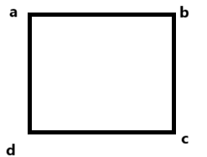
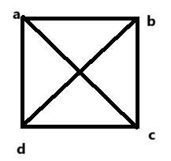
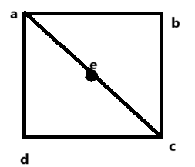
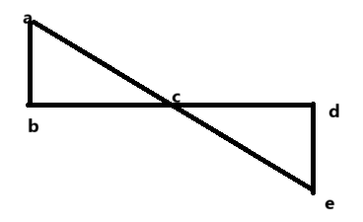
Acticity-2
Questions: Identify the Euler graphs amongst the following?

Slide 17
Conclusion
Eulerian graph are discussed.
Related examples are given.
ns

Slide 18
Video Links
https://youtu.be/HvFyVSSwF14?si=mz0BnrlIgPhxlT3t
https://youtu.be/H8aPbP86WyE?si=J3iZlys16PdHvUWY
(Video Links)
https://drive.google.com/file/d/1zm_o2dthNGIi-OXsgP8McUz4SUlb9q3p/view?usp=sharing
(Book Link)

Slide 19
References
Sr. No. | Author | Name of the Book | Publisher | Year of Publication
1 | Kenneth H. Rosen | Discrete Mathematics and Its Applications | McGraw-Hill | 2019
2 | C. L. Liu | Elements of Discrete Mathematics | McGraw-Hill | 1996
3 | J. P. Tremblay, R. Manohar | Discrete Mathematical Structures with Applications to Computer Science | Tata McGraw Hill | 2001
4 | Kolman, Busby, Ross | Discrete Mathematical Structures | PHI | 2001
5 | Narsingh Deo | Graph Theory with Applications to Engineering and | PHI | 2017

Slide 20
Thanks!!!

